Slide 1
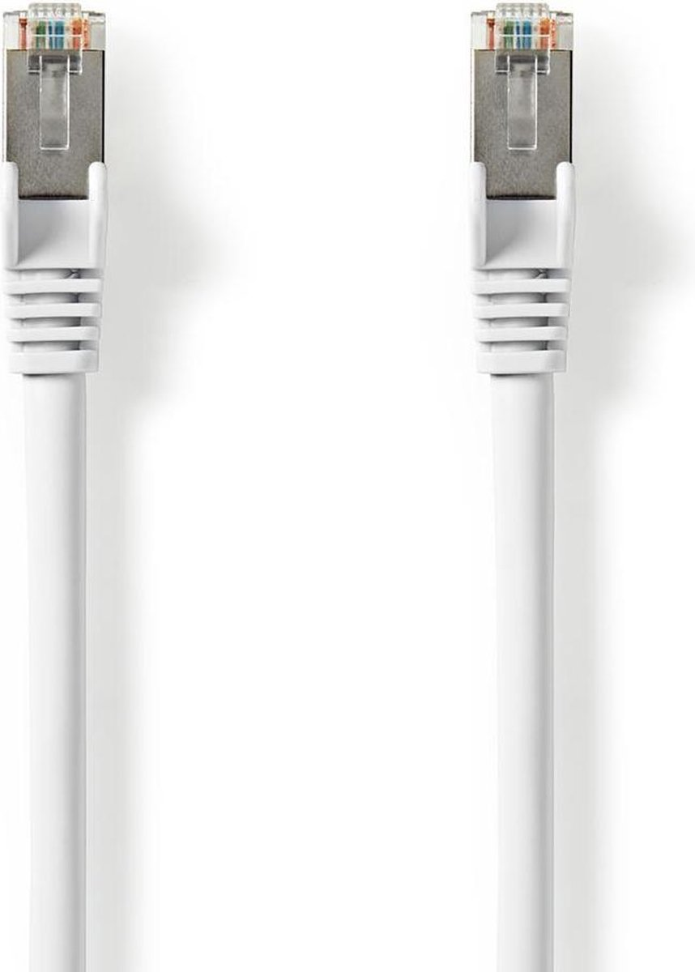
SMART THORN IN A DIGITAL SIDE
Cardiff, May 20th 2021
Notes:
Research by Fontys University Applied Science; collaboration Readership AI & Big Data and Journalism and Responsible Innovation (January 2019 - December 2019)

Slide 2
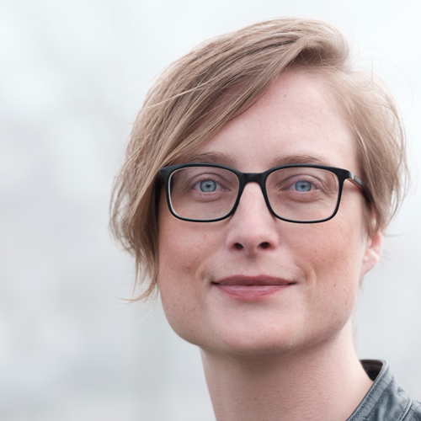
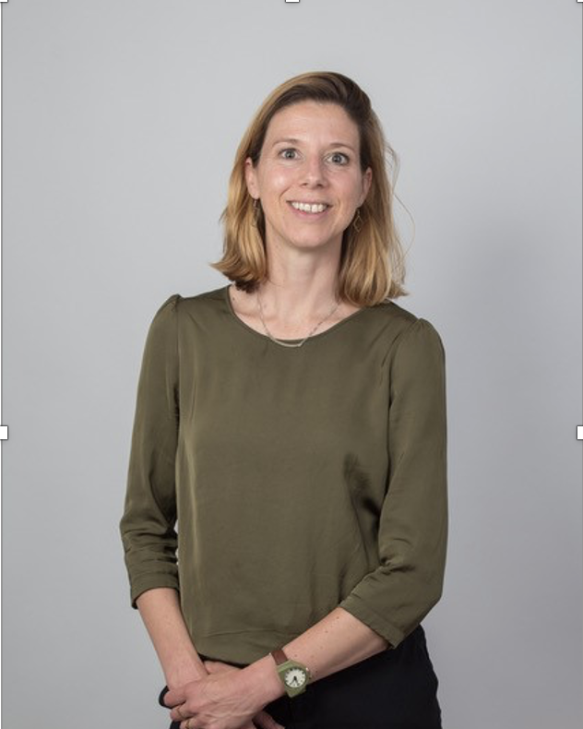
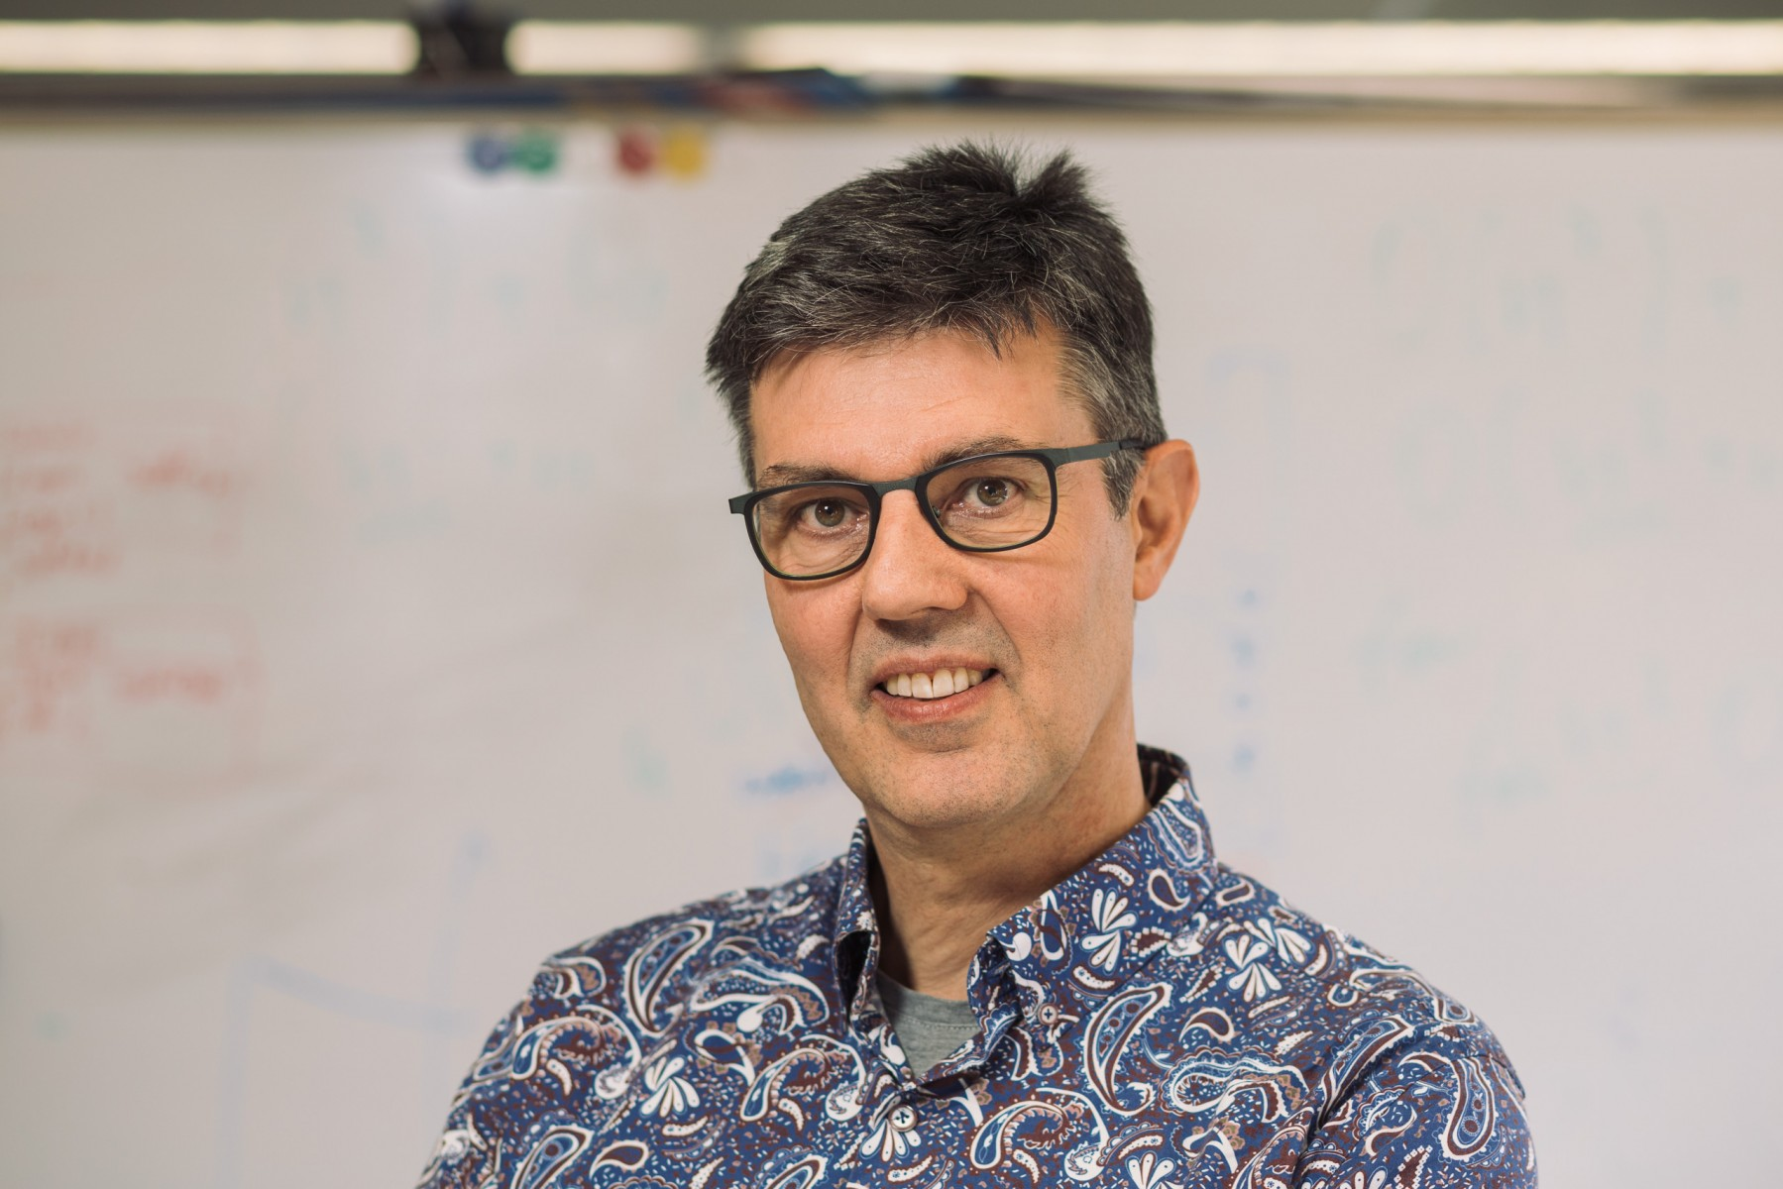
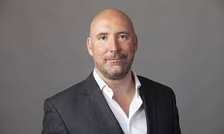
TEAM
Notes:
Jo-An Kamp (ICT AND ETHICS), Danielle Arets (JOURNALISM), Gerard Schouten (AI), Leon Heuts (PHYLOSOPHY AND ETHICS), Martina Huynh (DESIGN AND DATA)

Slide 3
BROWN DATA?
Notes:
Although a growing number of cities have embraced a Smart City Strategy, this is not accompanied with undivided enthusiasm. Over the past decades, a growing number of scholars have pointed out that business interests have taken precedence over social and cultural interests in the Smart Cities (Harvey, 200). Because of the potential for new services, many companies want to turn a city into a Smart City market (Chen et al, 2014, p. 175). With the eager interference of companies in urban dynamics, new power relations arise that need to be critically examined (Hollands, 2008). This concerns questions like for instance questions of who the data belongs to. These questions often lead to a great deal of uncertainty, both politically and legally as clear rules and guidelines are lacking (Thierer, 2014).
On top of this citizens are hardly consulted about smart city developments. A growing number of scholars stress that citizens should have a stronger voice in smart city developments; eg to discuss smart new forms of administration, manners and responsible use of data and, above all, to consider how the 'smart citizen' wants to operate in that city (Frissen et al, 2018, Leonard, 2016, Van Dijk et al, 2016. Schaefer, Van Es, Meijer, 2016).
In the research project Smart Thorn in a Digital Side we explored if and how journalists are reporting on smart city developments; are they able to stimulate a meaningful debate on these matters?

Slide 4
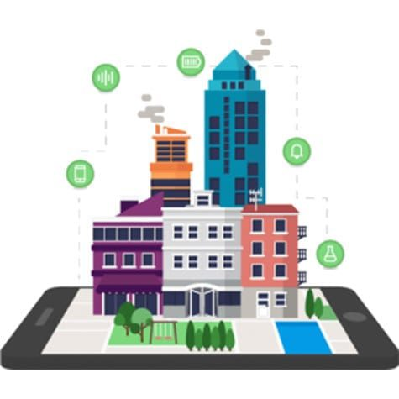
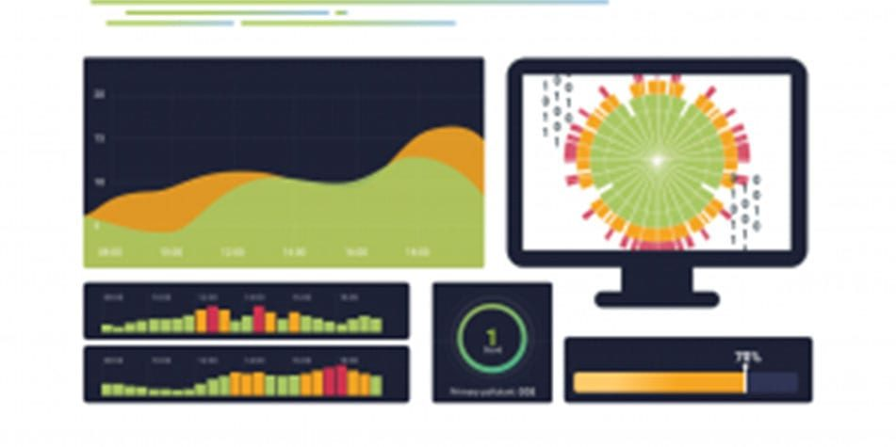
Smart City District Helmond: one big fieldlab
Smart residential and working area where the urban environment has been designed in conjunction with new technologies for transport, health, energy generation and storage and circular construction.

Slide 5
Research
Goal: to determine whether smart cities have been adequately discussed in public debates
Discourse analysis to indicate how the topic of smart city was addressed in the local and national media (2015-2019).
qualitative semi-structured interviews with journalists, chief editors, policy makers and aldermen in three smart cities in the Netherlands.
research findings were used as input for technical and ethical toolkit that was tested with journalism students.

Slide 6
Discourse analysis: polarity
Notes:
In our first phase, we examined journalistic articles, between January 2015 and December 2019, in both national and local newspapers making use of the journalistic database Lexis Nexis.
National news outlets cover topics around smart city developments in the aforementioned three cities more frequently, as opposed to local outlets. In the period (2015 to 2018), a total of 903 articles appeared in Dutch news media on the theme of Smart City and Digital City (search terms: smart city, data-driven, data & city, digital city).
The number of articles has remained almost the same in four years:
year
2015: 244
2016: 216 items
2017: 202 items
2018: 231 items
A sentiment analysis was made using Phython textblob (a basic programme within Natural Language Processing). Machine learning can be used to determine which words are positively or negatively charged. As many words as possible (especially verbs and adjectives) were analysed at the individual text level, on the basis of which the level of polarity and subjectivity could be determined.
Between 2015 and 2018, the theme of data-driven control, as this analysis shows, was predominantly reported as 'neutral'.

Slide 7
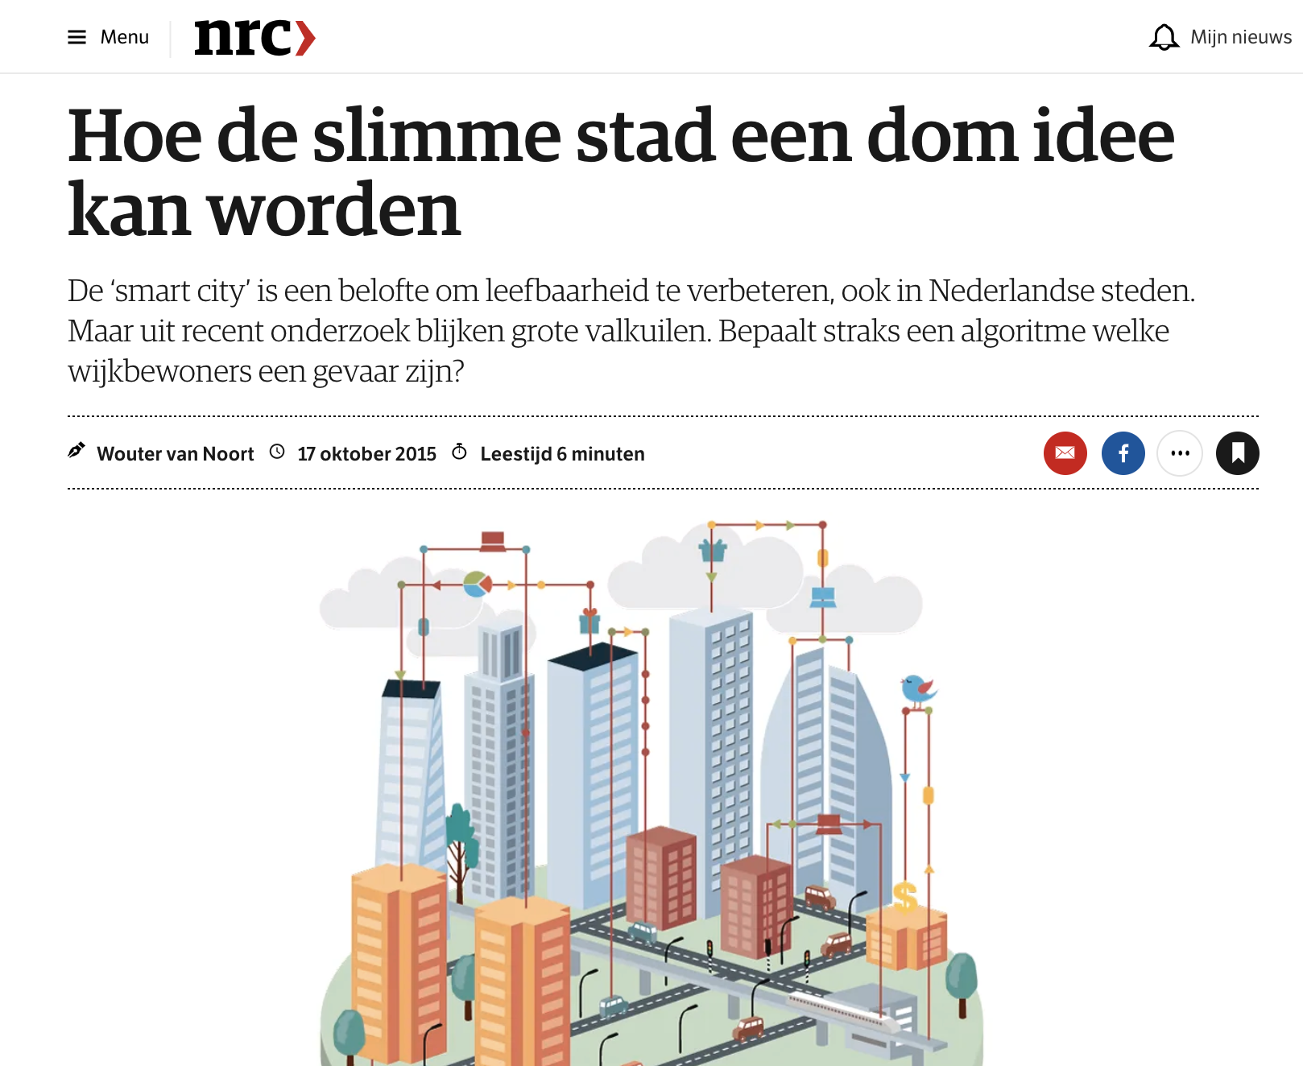
Insights 1/2
Underappreciation in local newspapers / sentiments mainly optimistic
More coverage in national newspapers / sentiments more critical

Slide 8
Interviews journalists
I know it will have a huge impact. But I like to work on the basis of case studies. What does it mean for ordinary people? The topic of smart cities is too abstract for me.
GDPR… Well, I heard about it…
I wrote about the start of the smart district. After the test, I asked the city council for the evaluation. They wouldn't give it to me, so I thought: fuck it!
I never have a problem with cameras. I think if you have nothing to hide, it's no problem. You just have to behave.
Notes:
In the second phase, semi-structured interviews were conducted with 6 journalists, 2 chief editors, 2 alderman and 3 policy makers of local outlets in Eindhoven, Tilburg and Helmond. Topics that were touched upon were interest and knowledge on smart city developments, personal opinions on these developments and the role of journalism within smart city transformations.
The interviews revealed a great lack of knowledge and digital skills. 5 out of 6 consulted Journalists and chief editors mention they were hardly aware of discussions around smart city developments. Furthermore, 2 of them mention a lack of interest to critically examine developments as ‘the public would not be interested’ or the ‘topic is too abstract to translate into a good story’. When bringing up specific developments as the GDPR, 2 journalist mentioned they hardly knew what it was about.
This lack of knowledge and interest in these developments does not only apply to journalism. Civil servants are also struggling with this as well. The 2 civil servants and aldermen we interviewed mentioned they need to be better informed on the manner. Furthermore they appointed at the need for a more public debate as they feel important decisions are being made without good public deliberation on these matters.

Slide 9
Insights 2/2
Technical knowledge and digital skills of journalists (and civil servants) are limited
Ethics strongly based on personal perception
Time is limited / restricting further research
People don’t know which questions to ask…

Slide 10
A FREE TOOLKIT THAT HELPS USERS TO MAKE BETTER DECISIONS
ON THE IMPACT OF TECHNOLOGY
WWW.TICT.IO
Notes:
Why a toolkit? Because we want to help you design, invent or use technology that makes a positive impact on society.

Slide 11
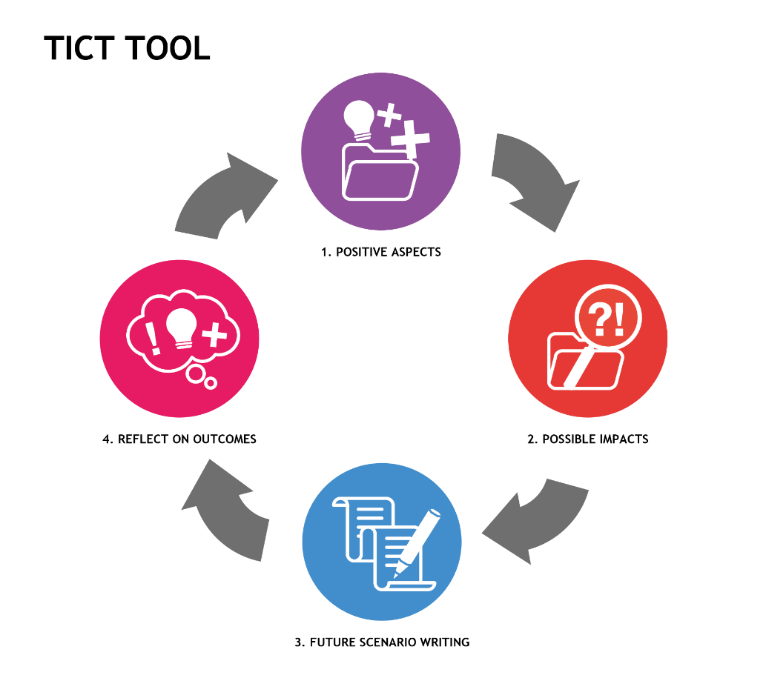
Starting points while developing the tool:
Technology = multidisciplinary
Ethics as a driving force for innovation
Non-normative/ non-judgmental
Part of the (design cycle) process
Context is king
positives
balance
risks
future scenarios
Notes:
But, based on what should we go on? What should be our guiding lights? Here are my suggestions:
1. Technology should be multidisciplinary
Thinking about the impact of technology is important for both tech and non-tech students as well as for professionals. Multidisciplinary teams with different backgrounds should be encouraged, because the people you make your products for might be diverse and possibly not represented by your team elsewise. Discussions from different viewpoints should be encouraged and if you disagree on things, it might just be an indication to dive deeper.
2. Ethics as a driving force for innovation An important thing we should avoid is to use ethics as a criterium for what not to make or what not to do. The case should be how to make or do things in a better sense. So, the question we have to ask here is not: “Are we pro or contra”? but “How are we going to design or redesign human-technology interactions in favor of our well-being?”
3. Non-normative Peter-Paul Verbeek argues not to judge but to guide technological development. I can add here that our role as a university is not to decide what our students should think or what the moral just answer should be to an ethical dilemma, but to let our students make up their own minds. The questions we ask should therefore be non-normative: there may not be such thing as an absolute wrong or right, there are just a lot of options and choices to make.
4. Part of the (design cycle) process
Consciousness and discussion are important factors: recognizing human values, wondering whether your values ​​are central or at stake. And, as most design and development processes are cycles, asking questions should be a part of each stadium of the process. So, we have to apply ethics “from the inside out”, and not “from the outside in” or only at the end, as is often the case in ethical discussions (Lancee, Prüst, & Kamp, yet to be published).
5. Context is king
There are no ‘one size fits all’ solutions here, as every case has a different context. From the vision of Mediation Theory ethics should not be limited to whether or not a technology is acceptable (a yes/no question), but should be concerned with how a new technology could get a place in society and how that affects our human values, considering the impact of this specific technology within its applied context.
So, to avoid possible future tech regrets like Berners-Lee, Zuckerberg, Dorsey e.a., we should ask ourselves a lot of questions and start discussions in each stage of the design process (called ethics from within). Doing so we can design, invent or use technology with positive impact on society!

Slide 12
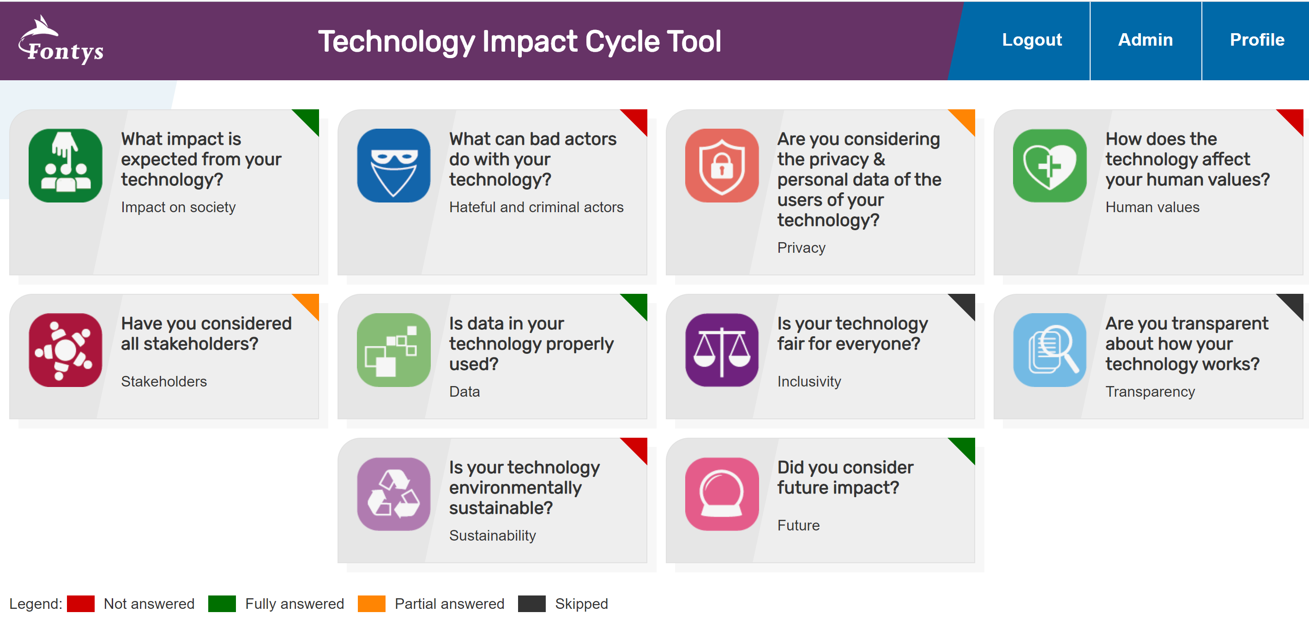
Notes:
A lot about technology, but also a lot about the human side of that…

Slide 13
Questions, a lot of questions…
Did you consider all stakeholders, even the ones the might not be your user or target group, but still might be of interest?
Is there any recourse for people who feel they have been incorrectly or unfairly assessed?
In what way is your technology contributing to a world you want to live in?
What negative effects do you expect from your technology?
Did you make any changes to the design of your technology because of these questions?
How could bad actors use your tech to subvert or attack the truth?
Does your technology register personal data? If yes, what personal data?
What are the main users/targetgroups/stakeholders for your technology?
In what way do you consider the fact that data is collected from the users?
Are your algorithms transparent to the people impacted by them?
What could potentially become the equivalent of fake news, bots or deepfakevideos on your platform?
Do you think your technology is compliant with prevailing privacy law and can you motivate why?
In which way can you imagine a future impact of the collection of personal data?
How does the technology influence the user(s) ability to make his own decisions?
What is the effect of the technology on the health and/or wellbeing of the user(s)?
How is your technology going to solve the problem?
Is your technology environmentally sustainable?
What impact is expected from your technology?
Does your technology have a built in bias?
Did you consider future impact?
Is your technology fair for everyone?
Impact
Bad actors
Privacy
Human values
Stakeholders
Data
Inclusivity
Transparency
Sustainability
Future

Slide 14
Outcomes and conclusion
Journalism students (and eldermen) noticed that there was no need to code or program theirselves to be able to judge on the impact of technology on society
The questions and categories helped to broaden their scope
It made them feel more secure
this conversational toolkit helped them improving public debates around smart cities
WITH THIS TOOLKIT, EVERYONE CAN BE
A SMART THORN IN A DIGITAL SIDE

