Slide 1
Aim, question and method
Aim: To construct an overview or “landscape” of concepts which integrate the dimensions of educational programme, research and professional practice
Research question: Which available concepts shape the integration between the three dimensions in which way and what are their relationships?
Method:
A dataset of a systematic review into cross-sectoral collaboration between higher education and public service organizations was used.
In total 1835 titles of peer-reviewed articles were coded and categorized into concepts which integrate two or three of the dimensions.
These results were suplemented by experts from the WIN research group, with backgrounds in higher education, research and professional practice.

Slide 2
Results – Categorizing concepts
Categorizing concepts: structure and process
Structure-based concepts (environmental, infrastructural or place-based) | Process-based concepts
Community based education | Service learning
Living lab | Workplace learning (or work-integrated- or work-based-)
Centre of expertise | Professional learning community
Academic workplace | Community of practice
 | Interprofessional collaboration
 | Action research (incl. PAR, SAR and PALAR)
Community based participatory research
Hybrid learning configurations/environments
Professional workplaces
Duinkerke, Snoeren, Jacobs & Bongers (work in progress)

Slide 3
Results - Graphical model plotting education-research-practice integrative concepts
(Quality and Innovation of) Professional practice
dimension
Triggers to collaborate
Resources
Institutional environment
Mandates
Window of collaborative opportunity
Vulnarable to policy/political change
Needs to address public issue
Sector failure
Resources from nongovernmental partners to solve issues
(Bryson et al. 2015)
Outcomes
Knowledge development
Practice innovations
Development of professionals
Improved cross-sector collaboration
New (network) connections and possibilities
Improved and practice-authentic curricula
Education-Practice
Research-Practice
Education
Research
Practice
Educational programme
dimension
Research
dimension
Education-Research
Duinkerke, Snoeren, Jacobs & Bongers (work in progress)

Slide 4
Results - Graphical model plotting education-research-practice integrative concepts
(Quality and Innovation of) Professional practice
dimension
Triggers to collaborate
Resources
Institutional environment
Mandates
Window of collaborative opportunity
Vulnarable to policy/political change
Needs to address public issue
Sector failure
Resources from nongovernmental partners to solve issues
(Bryson et al. 2015)
Interprofessional collaboration
Community based education
Professional learning community
Community of practice
Lecturer-
practitioner
Hybrid learning environments
Science-practitioner
Action-researcher
Centre of expertise
Action research
CBPR
Outcomes
Knowledge development
Practice innovations
Development of professionals
Improved cross-sector collaboration
New (network) connections and possibilities
Improved and practice-authentic curricula
Education-Practice
Research-Practice
Professional workplaces
Living lab
Service learning
Workplace learning
Academic workplace
Education
Research
Practice
PALAR
Educational programme
dimension
Research
dimension
Education-Research
Duinkerke, Snoeren, Jacobs & Bongers (work in progress)

Slide 5
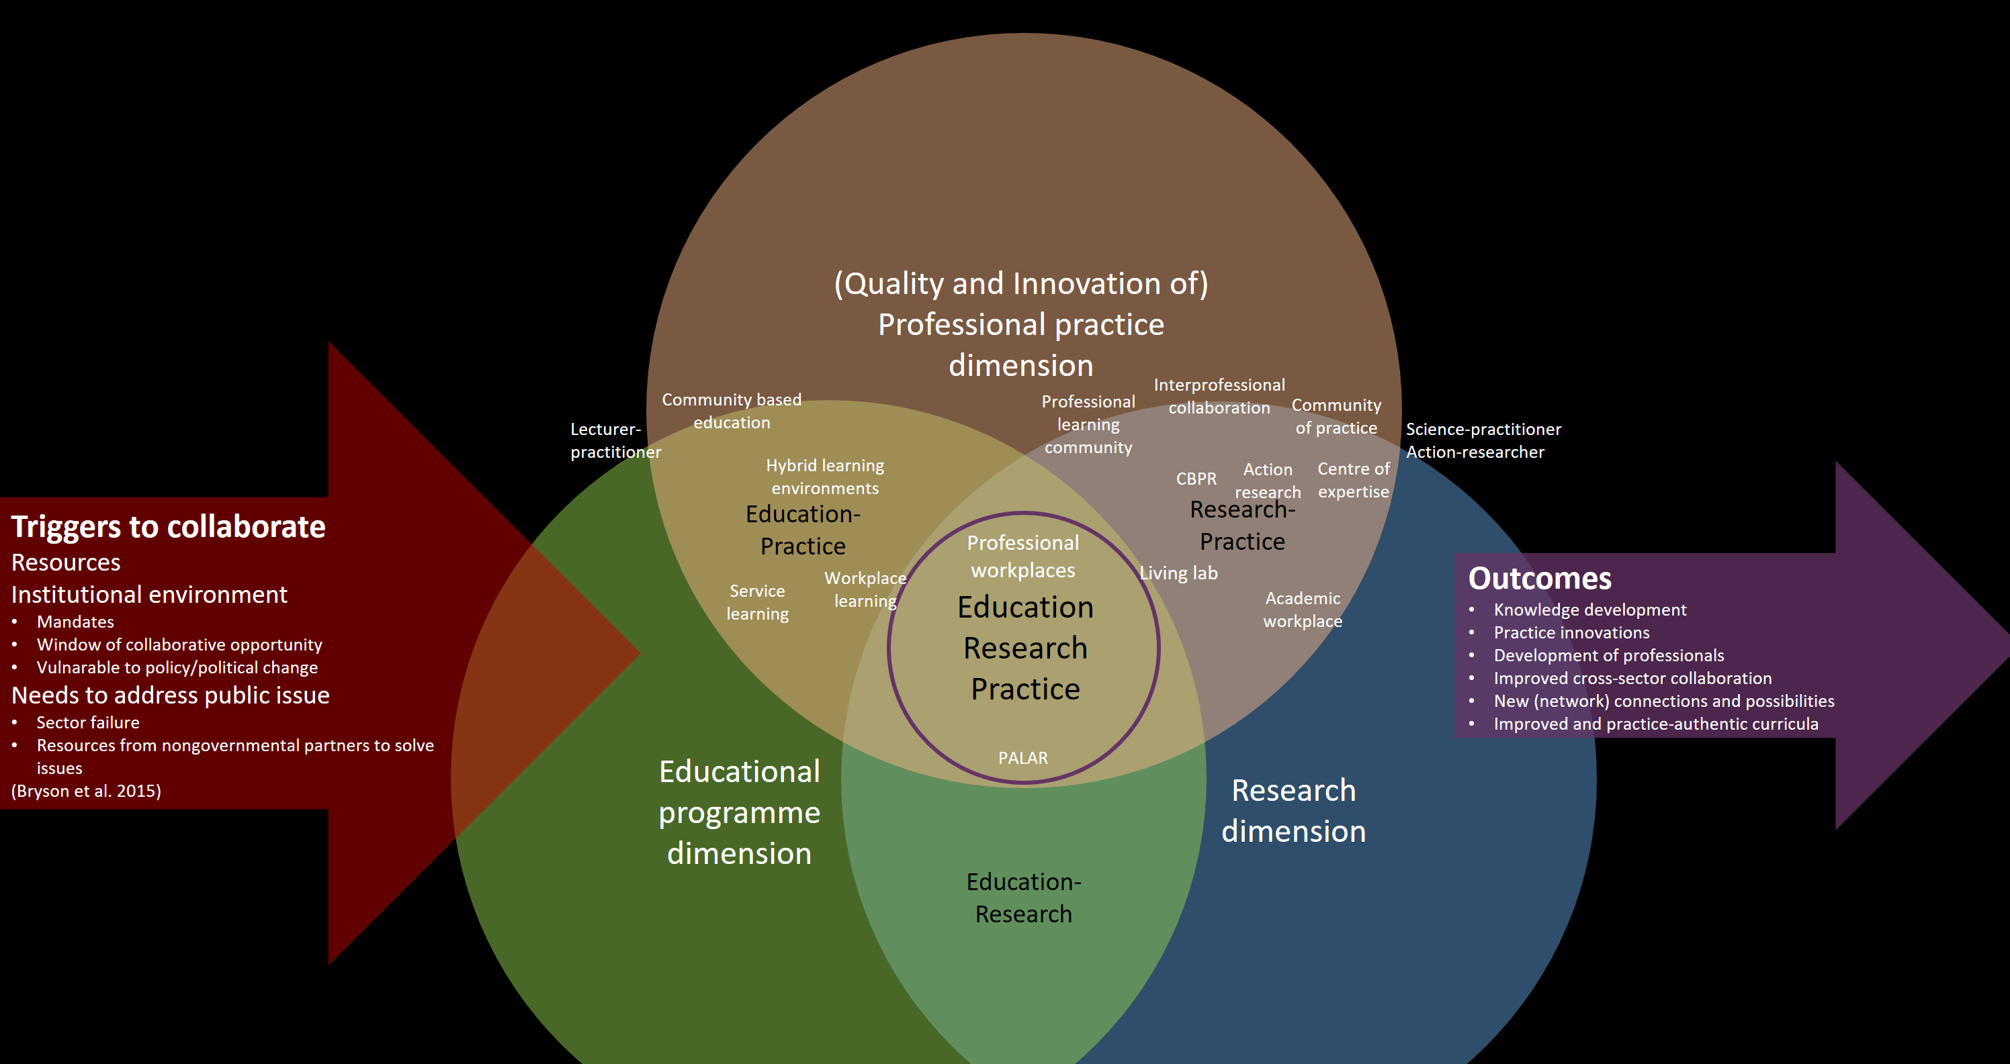
Results - Graphical model plotting education-research-practice integrative concepts
Duinkerke, Snoeren, Jacobs & Bongers (work in progress)

Slide 6
Results - Graphical model plotting education-research-practice integrative concepts
(Quality and Innovation of) Professional practice
dimension
Triggers to collaborate
Resources
Institutional environment
Mandates
Window of collaborative opportunity
Vulnarable to policy/political change
Needs to address public issue
Sector failure
Resources from nongovernmental partners to solve issues
(Bryson et al. 2015)
Interprofessional collaboration
Community based education
Professional learning community
Community of practice
Lecturer-
practitioner
Hybrid learning environments
Science-practitioner
Action-researcher
Centre of expertise
Action research
CBPR
Outcomes
Knowledge development
Practice innovations
Development of professionals
Improved cross-sector collaboration
New (network) connections and possibilities
Improved and practice-authentic curricula
Education-Practice
Research-Practice
Professional workplaces
Living lab
Service learning
Workplace learning
Academic workplace
Education
Research
Practice
PALAR
Educational programme
dimension
Research
dimension
Education-Research
Duinkerke, Snoeren, Jacobs & Bongers (work in progress)

Slide 7
Conclusions
Most integrative concepts are either more structure-based or more process-based, only few concepts combine these.
Most concepts integrate two dimensions, professional workplace integrates all three dimensions.
PW is strong as an integrative structure concept, but moderate as an process-based concept.

Slide 8
Questions
Welke vragen roept dit op?
Welke (aanvullende) argumenten zijn er nodig om de positionering van een individueel concept te bepalen?
Hebben jullie aanvullingen van belangrijke (internationale) concepten die hierin gepositioneerd kunnen worden?

