Slide 1
Fontys Digital Library
Mediatheek Moller
Jos Knubben & Olaf Schiltmans
2020, december 8

Slide 2
Visible web or surface web
Deep web
(Not to be confused with the Dark web)

Slide 3
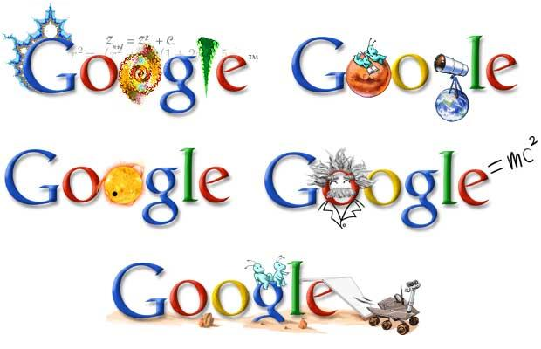
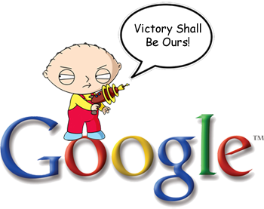
Google

Slide 4
Google Basic Search
Search:
flowers potted plants Netherlands export
Result:
Many hits (> 800,000), but relatively few
relevant search results!

Slide 5
Google Advanced Search
Search
intitle: flowers OR “potted plants” Netherlands export filetype:pdf
Result:
Less (119), but better search results!

Slide 6
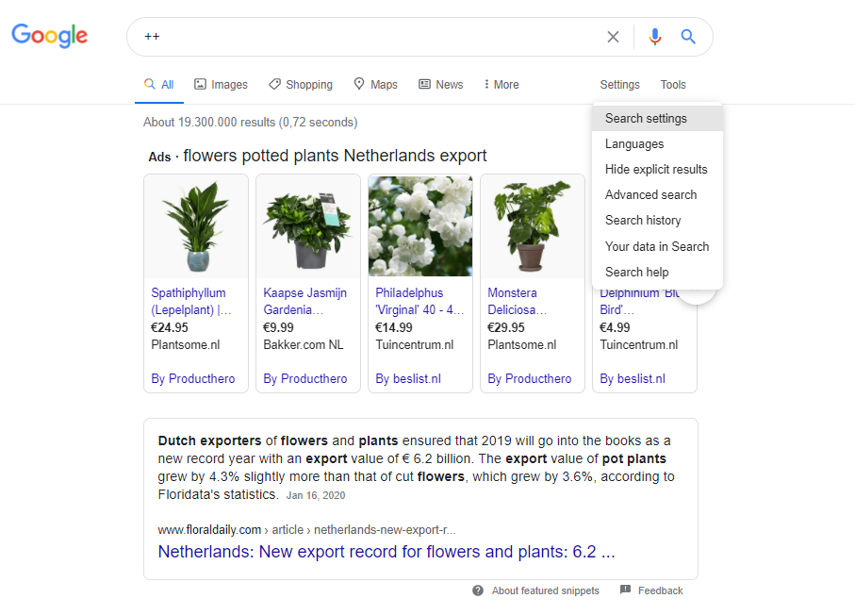
Google: Advanced Search
Settings
Advanced search

Slide 7
Visible web or surface web
“Grey area”
Deep web

Slide 8
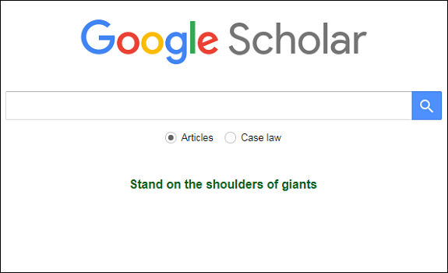
Google Scholar
https://scholar.google.com/
Search engine for finding scholarly publications

Slide 9
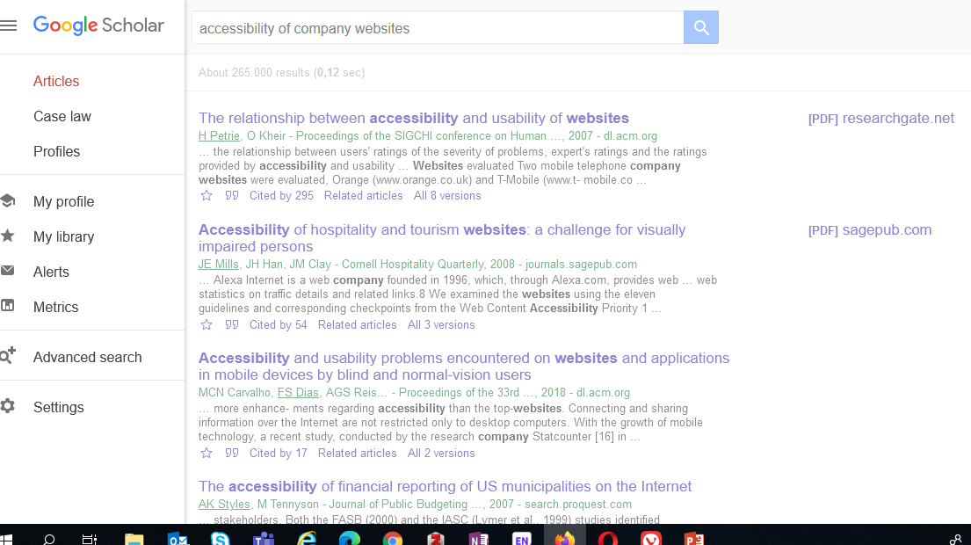

Slide 10
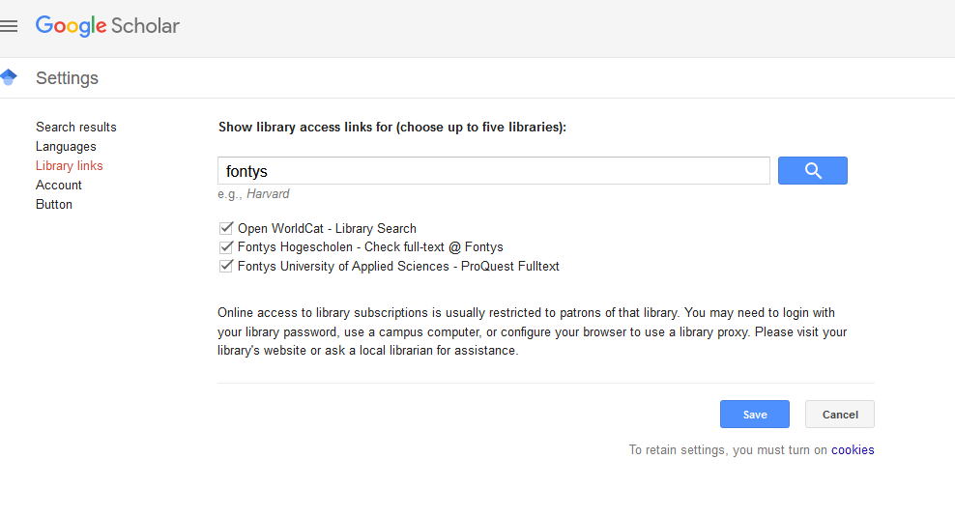

Slide 11
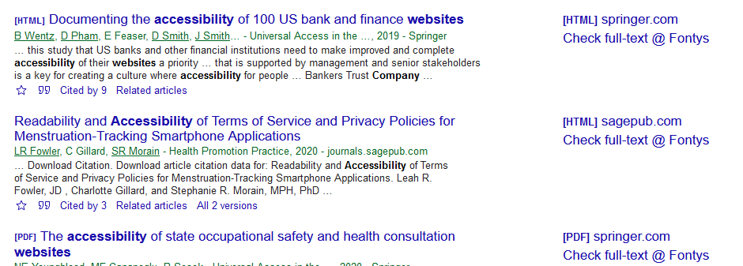

Slide 12
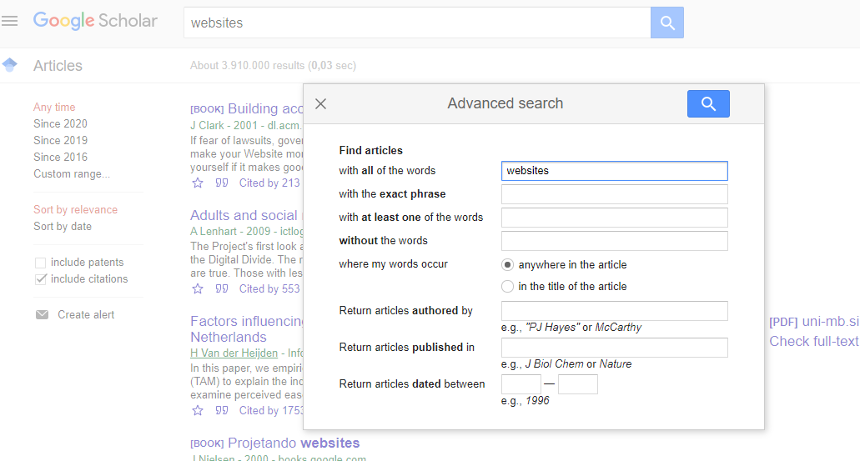

Slide 13
Visible web or surface web
“Grey area”
Deep web

Slide 14
What the library has to offer:
Newspapers
all Dutch newspapers
4,000 international newspapers
Company information
all Dutch companies
app. 91 million foreign companies
Statistics
Journals
app. 40,000 journals
app. 62 million articles
Market and branch reports
> 160,000
Netherlands and international
Country reports

Slide 15
Library Moller
https://fontys.nl/Moller.htm

Slide 16
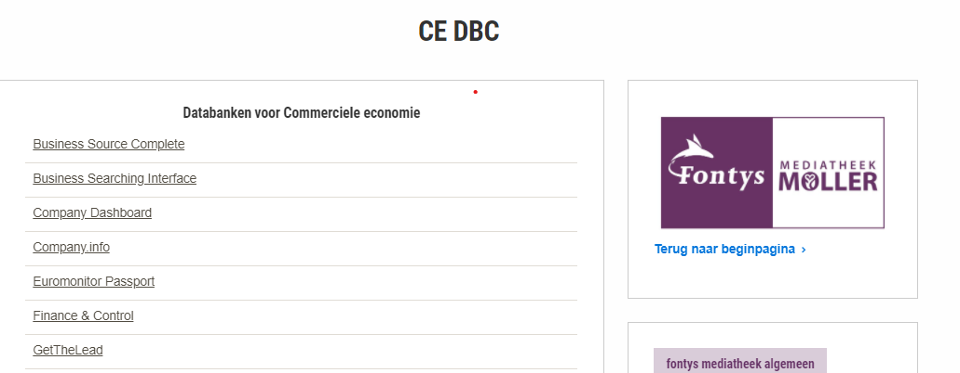
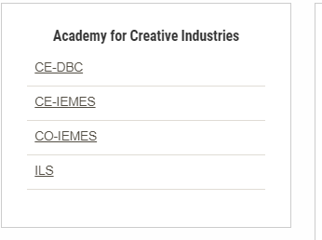
Library Moller

Slide 17
Company.info
Information relating to all Dutch enterprises (and foreign enterprises with branches in The Netherlands)
Annual results and ratios (including balances, profit & loss accounts) ;
Annual accounts;
Adresses en organisation details;
Management details (structure);
Press reports;
Benchmark tool to compare competitors;
App. 9,000 full text market reports.

Slide 18
Business Source Premier
International economic research database
> 2,300 full text periodicals: business, marketing, management;
Company profiles of 30,000 international companies;
> 160,000 industry profiles;
Country reports.

Slide 19
Business Searching Interface
Special interface of the database Business Source Premier
Country Reports;
Industry Profiles;
Company Profiles.
Very suitable for DESTEP or PESTEL analyses

Slide 20
NRIT Kennisbank
Reports and articles about the most important topics within the tourism and leisure sector, written by professionals in the field.
The Knowledge Base is published by the Netherlands Research Institute for Recreation and Tourism.

Slide 21
Statista
Research tool for finding statistics
80,000 topics;
18,000 sources;
175 industry reports;
4,500 dossiers;
100 country reports.

Slide 22
Nexis Uni
Newspaper database
Articles from all newspapers in the Netherlands:
Volkskrant, NRC, Algemeen Dagblad, Trouw, Brabants Dagblad, etc.;
Includes some news magazines and trade journals:
e.g. Elsevier, De Groene Amsterdammer, Quote, Trends Magazine;
Archive spans several decades
Built-in translate feature

Slide 23
Biep.nu
Fontys Search Engine
Search multiple Fontys databases simultaneously;
Particularly useful when not yet familiar with databases;
> 73 million items;
Almost 80% of our databases are indexed!
Do not use Biep.nu exclusively.

Slide 24
Bronvermelding in APA stijl De basis
Literature reference according to the APA-style

Slide 25
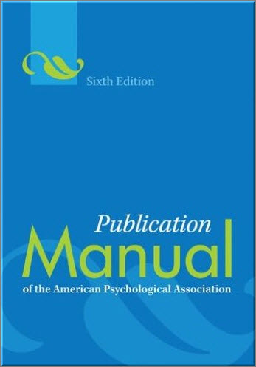
APA 6TH EDITION
American Psychological Association published rules how to refer to literature.
Notes:
Bronvermelding is verplicht.
Uniforme stijl maakt teksten en bronvermeldingen overal ter wereld herkenbaar.
Er zijn meerdere stijlen, maar bij TP wordt gebruik gemaakt van
De APA 6e editie, dit in navolging van veel Nederlandse universiteiten en Hogescholen

Slide 26
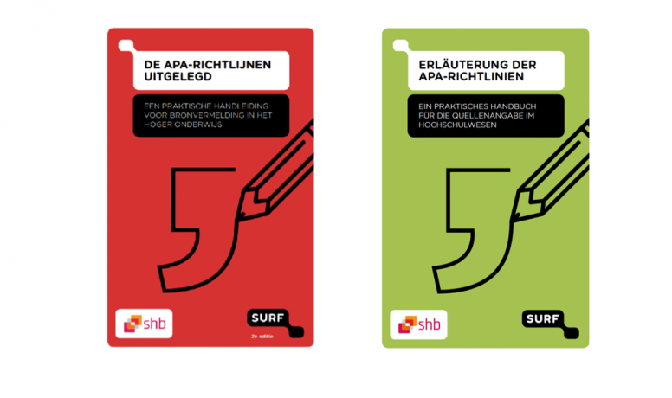
APA manuals
Download for free on: https://www.auteursrechten.nl/en/acknowledge-sources
In Dutch and German
Or for an English manual:
http://itswww.uvt.nl/lis/es/apa/apa-guide.pdf

Slide 27
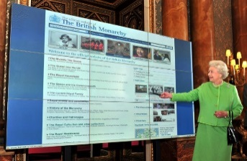
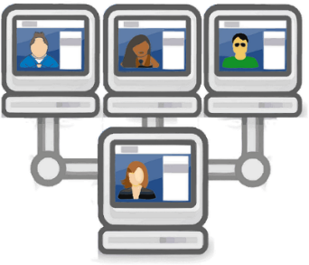
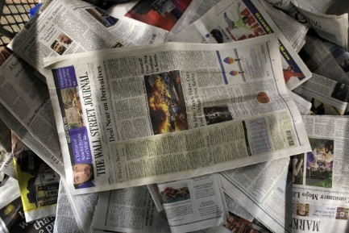
1.Determine type of source
APA has different guidelines for different types of sources such as:
books
articles
websites
tables
graphics
interviews
pictures
…
Notes:
Apa heeft verschillende richtlijnen voor verschillende bronnen, dus het maakt uit of je een youtube filmpje als bron gebruikt of een online artikel uit een databank of een bericht van de site van de NOS.

Slide 28
2. Reference in the text
Referring in the text can be done in 2 ways
Parafrase
author
Publication year
Quote
author
Publication year
Page number
quotes “ “
Notes:
Parafrase
Een parafrase is het in eigen woorden weergeven van andermans werk. Zet de verwijzing in de tekst ook direct bij de alinea waarin je andermans werk beschrijft. Je noemt de auteur en het publicatiejaar.
Citaat
Letterlijk een stuk test overnemen van iemand anders . In dit geval ook de naam van de auteur en het publicatiejaar en het paginanummer is verplicht. Het citaat ze je tussen dubbele aanhalingstekens

Slide 29
Citing a text
"Students often had difficulty using APA style" (Jones, 1998, p. 199).
According to Jones (1998), "students often had difficulty using APA style, especially when it was their first time" (p. 199).
Notes:
Hier twee voorbeelden hoe je parafraseren en citeren kunt weergeven.
Kijk in het document met de OSO Apa richtlijnen voor nog meer voorbeelden.

Slide 30
paraphrasing (to say it in your own words)
Never between “quotation marks”
Between brackets (Name authors (s), year, [p. X])
Page number is mandatory
Examples:
It is recommended to first analyse the problem or situation before the investigation(Migchelbrink, 2006, p.68)
In practice-based research for care and well-being, it is recommended to first analyse the problem (Migchelbrink, 2006) and then...
According to Jones (1998), APA style is a difficult citation format for first-time learners.

Slide 31
3. Literature list
All the sources you used are presented at the end of your report or paper
In alphabetical order
Don’t use –
•
■
Indent the second and next line
Notes:
In Word: inspringen: selecteer alles vanaf de tweede regel -> Ctrl T. Soms nog wat bijwerken met Delete

Slide 32
How to refer to a source which is quoted in another source?
In your text you refer to the source in which the information has been found.
According to Mecheler (in Berk, 2011) a three-year-old child can cycle without support wheels …

Slide 33
Personal communications
In a literature list there are only references that can be consulted by the reader, therefore interviews, e-mails, personal conversations, lessons, workshops, etc. are not mentioned. However, reference can be made in the text.
Example:
...but this is not the case (J. Jansen, personal communication, November 30, 2009) and will be...

Slide 34
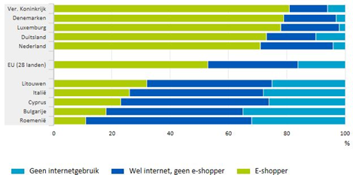
Tables and figures
Beneath the image
in addition to the number of the figure, give a short description, most logical to take over the description of the site. Next the data and web link of the image.
Figure 1. Online shopping 2015. Reprinted from "Meer Nederlanders shoppen online" by CBS, 2016 (https://www.cbs.nl/nl-nl/nieuws/2016/24/meer-nederlanders-shoppen-online). Copyright 2016, CBS.
Notes:
Voorbeeld tabel uit boek
Tekst … in Tabel 1 is te zien dat … Onder afbeelding Tabel 1. Indiceringsmethoden. Overgenomen (of: Aangepast overgenomen) uit Onderzoek doen! (p. 108) door T. Fischer en M. Julsing, 2014, Groningen: Noordhoff. Copyright 2014, Noordhoff Uitgevers. Bronnenlijst Fischer, T., & Julsing, M. (2014). Onderzoek doen! Kwantitatief en kwalitatief onderzoek (2e druk). Groningen: Noordhoff.

Slide 35
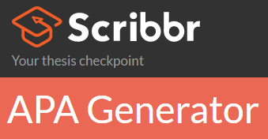
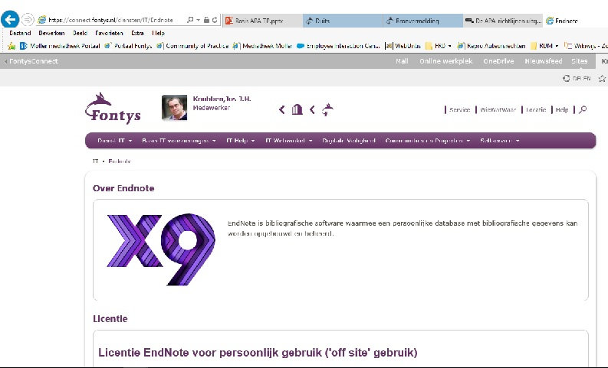
Tools
Notes:
Vraag hulp via de literatuurhelpdesk.
Word is populair. Op dit moment verwijzen naar de website van de HAN: APA en Word 2013.
Hulpmiddelen: controleer deze altijd met de richtlijnen.

Slide 36
CAUTION!
Always check
Complement/correct where necessary
Make sure you are consistent in applying the rules
If you are in doubt?
Feel free to ask your questions

Slide 37
Literature helpdesk
You search
We support
literatuurhelpdeskmoller@fontys.nl
How to contact the Literature helpdesk?
Send an email to literatuurhelpdeskmoller@fontys.nl;.
Or make an appointment with an information specialist via literatuurhelpdeskmoller@fontys.nl.

Slide 38
Questions?
Good luck with your research!
38

